Slide 1
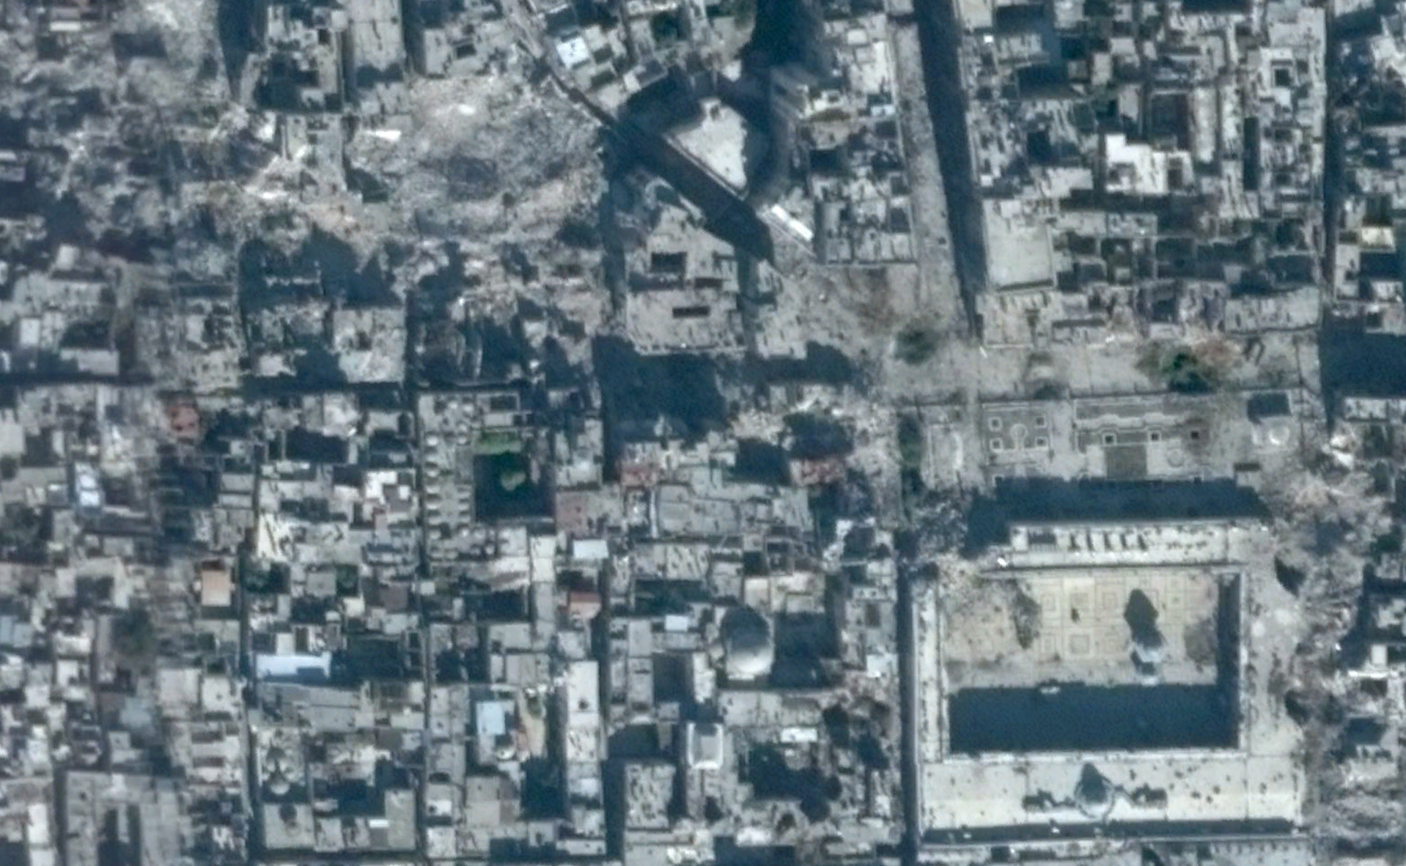
6. Dashboards and Data Pipelines
Jonathan Hersh (Chapman University Argyros School of Business)
12/8/2021

Slide 2
Outline
Data Lakes and Data Pipelines
What is Open Data?
Dashboards for Model Displays

Slide 3

Key Takeaways:
Why Do Public Policy Data Projects Fail?
Models can only be as good as your data pipeline (Bad data = bad model)
Build a consistent data lake first (excel files are bad)
All data and models should be an API (i.e. Application Programming Interface or structured way to access data)

Slide 4

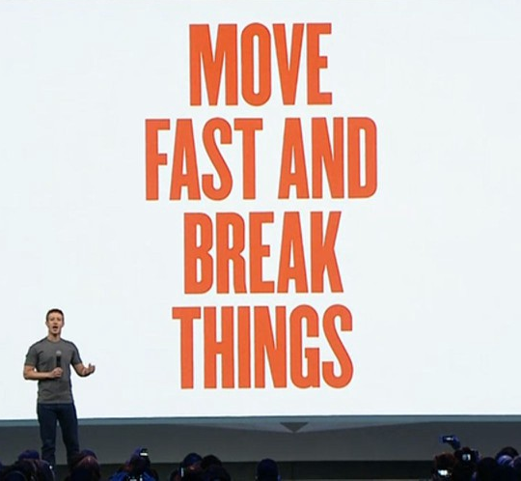
Class of Cultures Within Public Policy Organizations
Development organizations: academic culture, focused on publications, journals. Slow, careful, hierarchical.
Tech culture: build fast, design and revise. Experimental and see “what works.” Flat organization structure.
Unavoidable fact: development organizations produce knowledge products. Tech leads in how to organize production for knowledge products

Slide 5

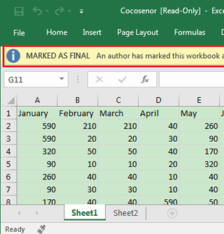

Perceptions of capabilities of Artificial Intelligence
Existing data infrastructure
+
=

Slide 6

Artificial Intelligence vs Machine Learning vs Deep Learning
“The deep in deep learning isn’t a reference to any kind of deeper understanding achieved by the approach; rather, it stands for this idea of successive layers of representations” – Francois Chollet

Slide 7
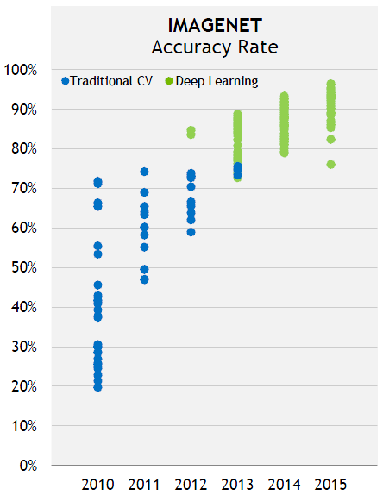
One Reason for The Deep Learning Hype: Images
Before deep learning, computers couldn’t recognize objects from images.
In 2012 researchers first used a deep learning model on the ImageNet competition, which tests an AI to recognize objects in images
But ImageNet had 1M+ images!
Translation: models and data are close complements

Slide 8










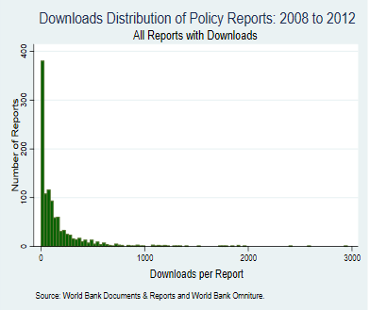
Modern Data Pipelines
API = structured way to access your model
Raw Data Transformation
Analysis
Dataset
Model Output Dataset
Raw Data
Data Viz Dashboard
Data Lake: a centralized repository that stores all your structured and unstructured data on demand and accessible by everyone
Report Few Will Read
Variable Creation
Modeling &
Exploratory Data
Analysis
Most economists only consider this portion of the data pipeline!

Slide 9
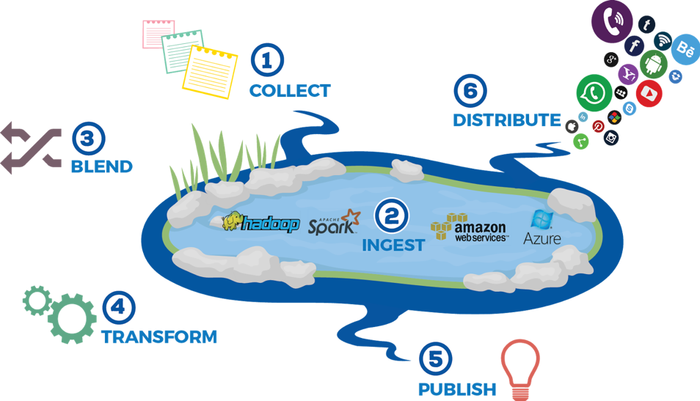

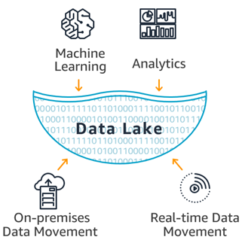
Many Options of Data Lakes to Choose From

Slide 10

Key Takeaways:
Questions at This Point
What’s best data lake?
What’s the best food when you’re starving?
Cloud for sure, open source if you can
What programming languages do I need to learn?
None really. Version control (git). R and Python will make your life easier. SQL variants (or just dbplyr)
Theme: Have a consistent data strategy and ensure everyone abides by it

Slide 11
Outline
Data Lakes and Data Pipelines
What is Open Data?
Dashboards for Model Displays

Slide 12
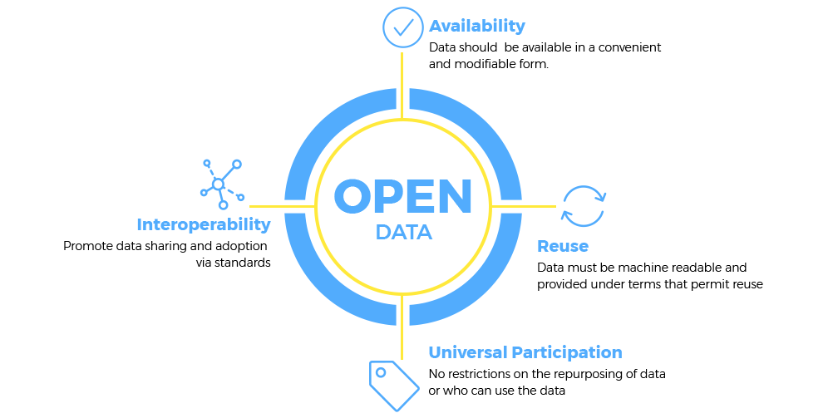
What is Open Data?

Slide 13
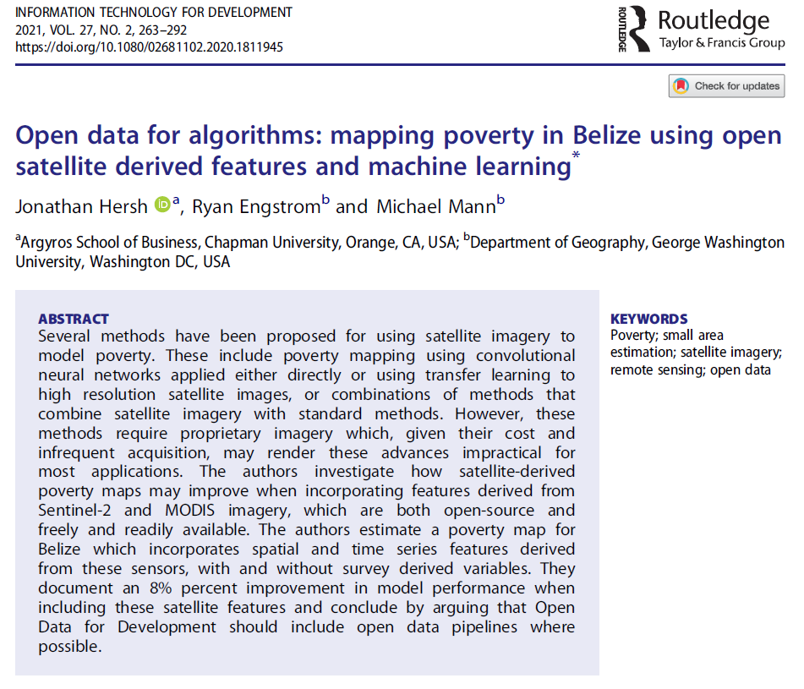
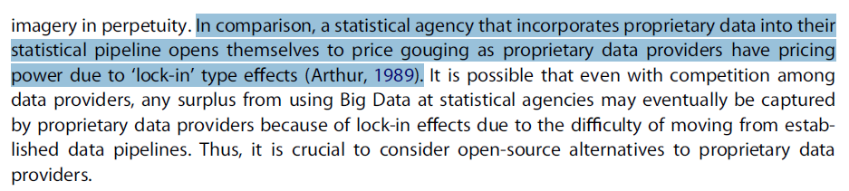
Why is Open Data Important?
https://publications.iadb.org/en/mapping-income-poverty-in-belize-using-satellite-features-and-machine-learning
https://www.tandfonline.com/doi/full/10.1080/02681102.2020.1811945?scroll=top&needAccess=true

Slide 14
Outline
Data Lakes and Data Pipelines
What is Open Data?
Dashboards for Model Displays

Slide 15
Outline
Data Lakes and Data Pipelines
What is Open Data?
Dashboards for Model Displays

Slide 16
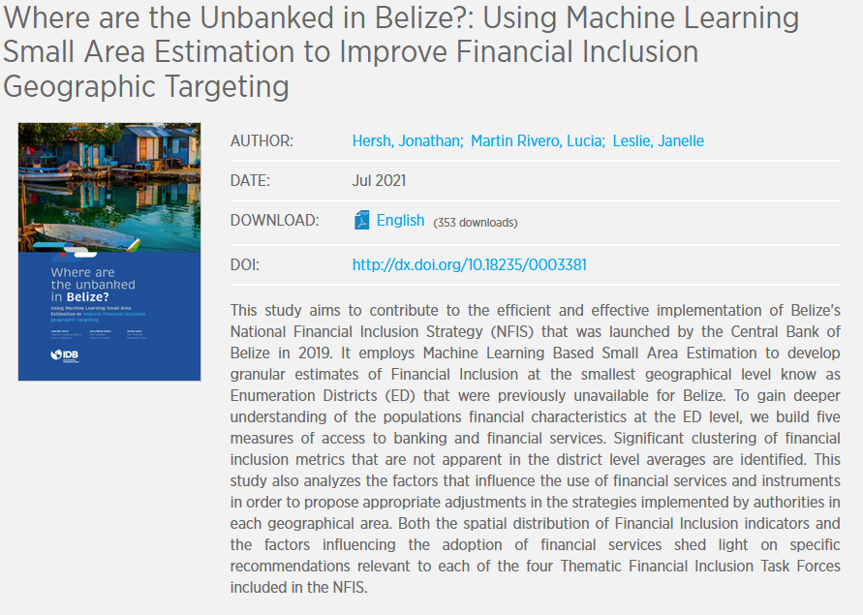
Example Dashboard Project: Financial Inclusion
https://publications.iadb.org/publications/english/document/Where-are-the-Unbanked-in-Belize-Using-Maching-Learning-Small-Area-Estimation-to-Improve-Financial-Inclusion-Geographic-Targeting.pdf

Slide 17
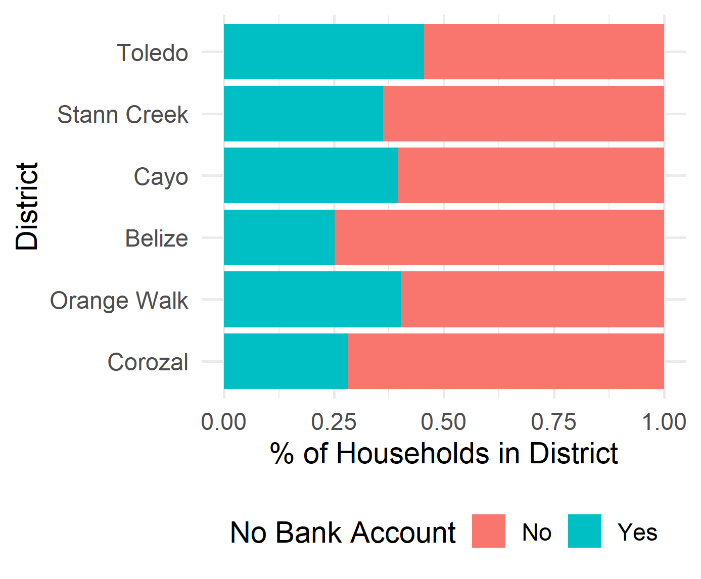
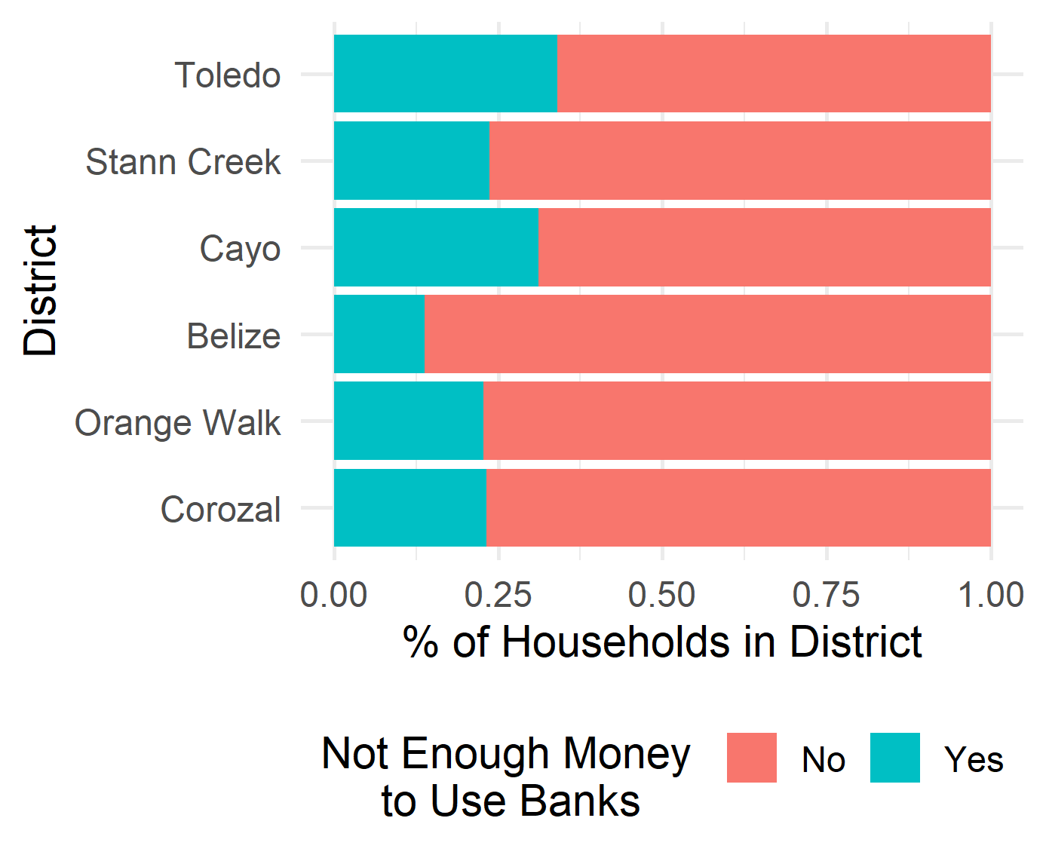
Measures of Financial Inclusion – Unbanked + Barriers to Banking
1) Does anyone in the household have an account at a credit union or a bank? (FI module question 1)
2) Is the reason you do not have an account at a bank or credit union because you don’t have enough money to use them? (FI module question 3-F)

Slide 18
Modeling Approach
2010 Belize Census
75,000 households
Labor Force Survey
April 2019 Wave
2,216 unique households
Household level outcome to model: One of four Financial Inclusion Question
Test/Validation approach
75% data training (estimation) sample and 25% test (validation)
Models
Random Forest each made up of 500 decision trees
Intersection of Census and LFS Surveys had 26 transformed variables

Slide 19
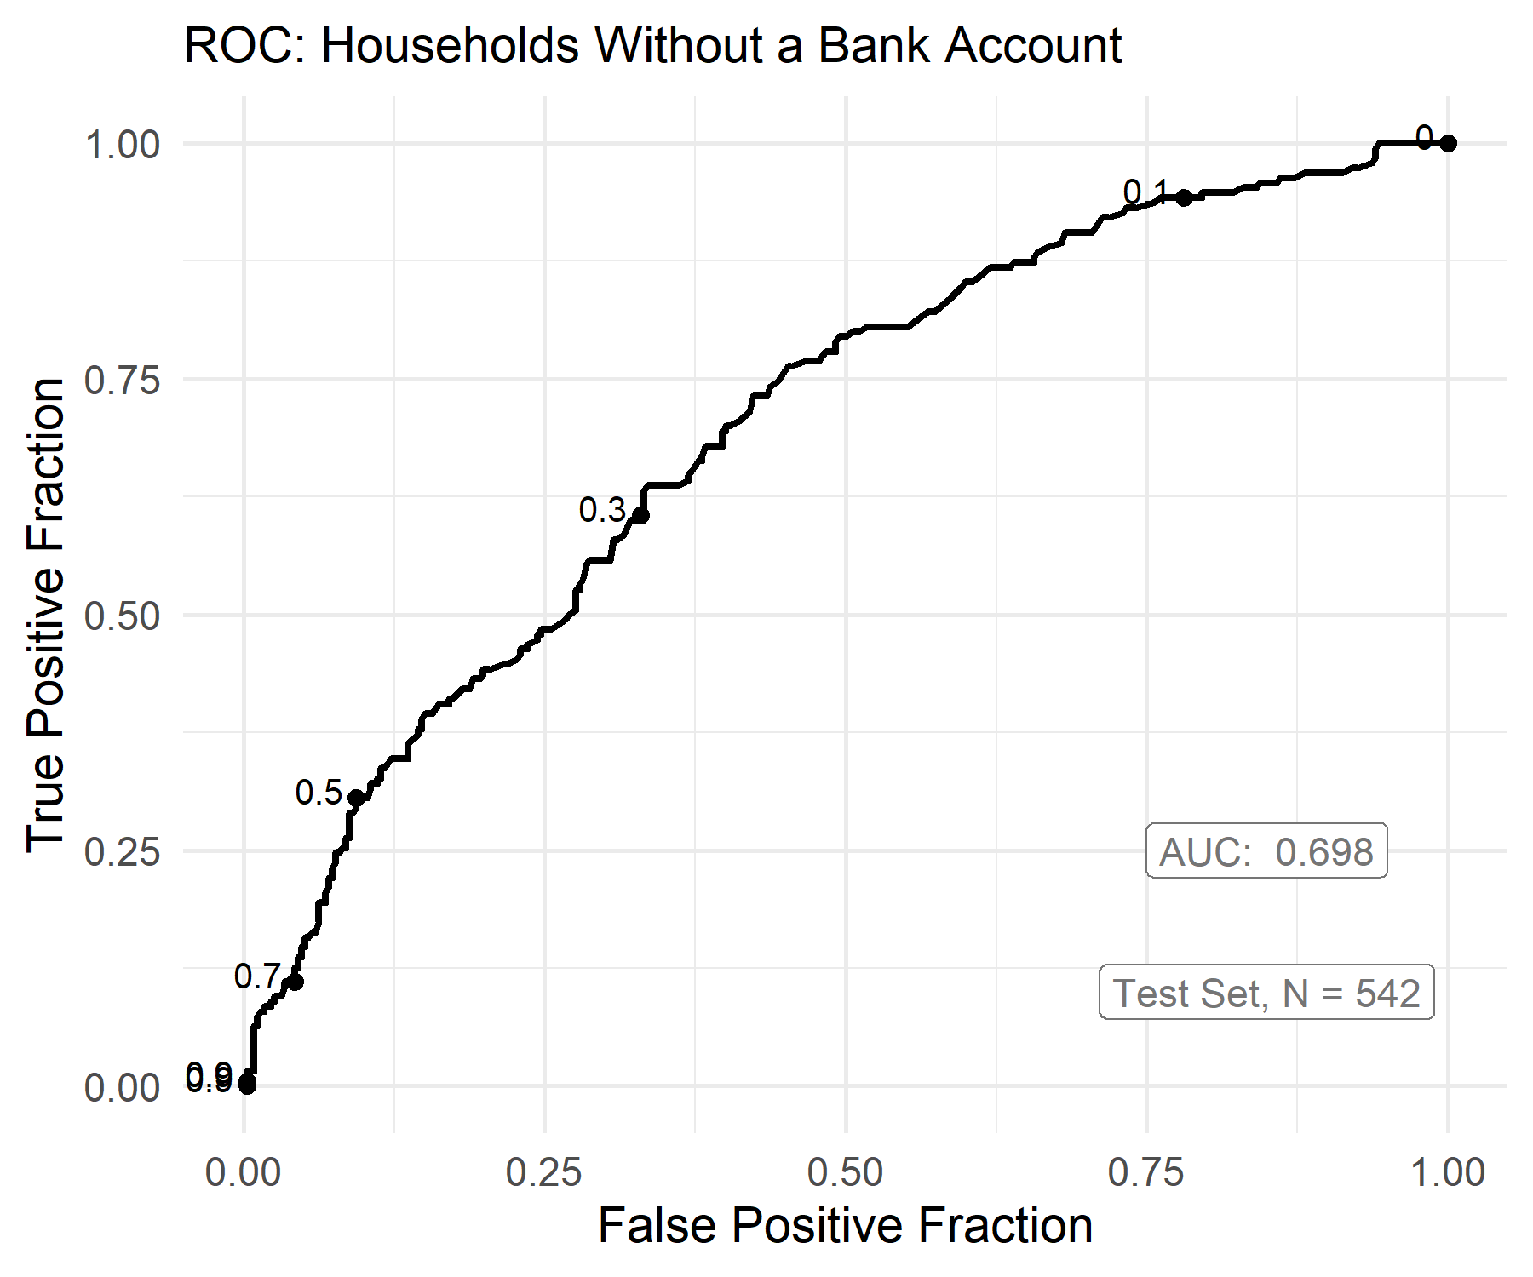

Slide 20
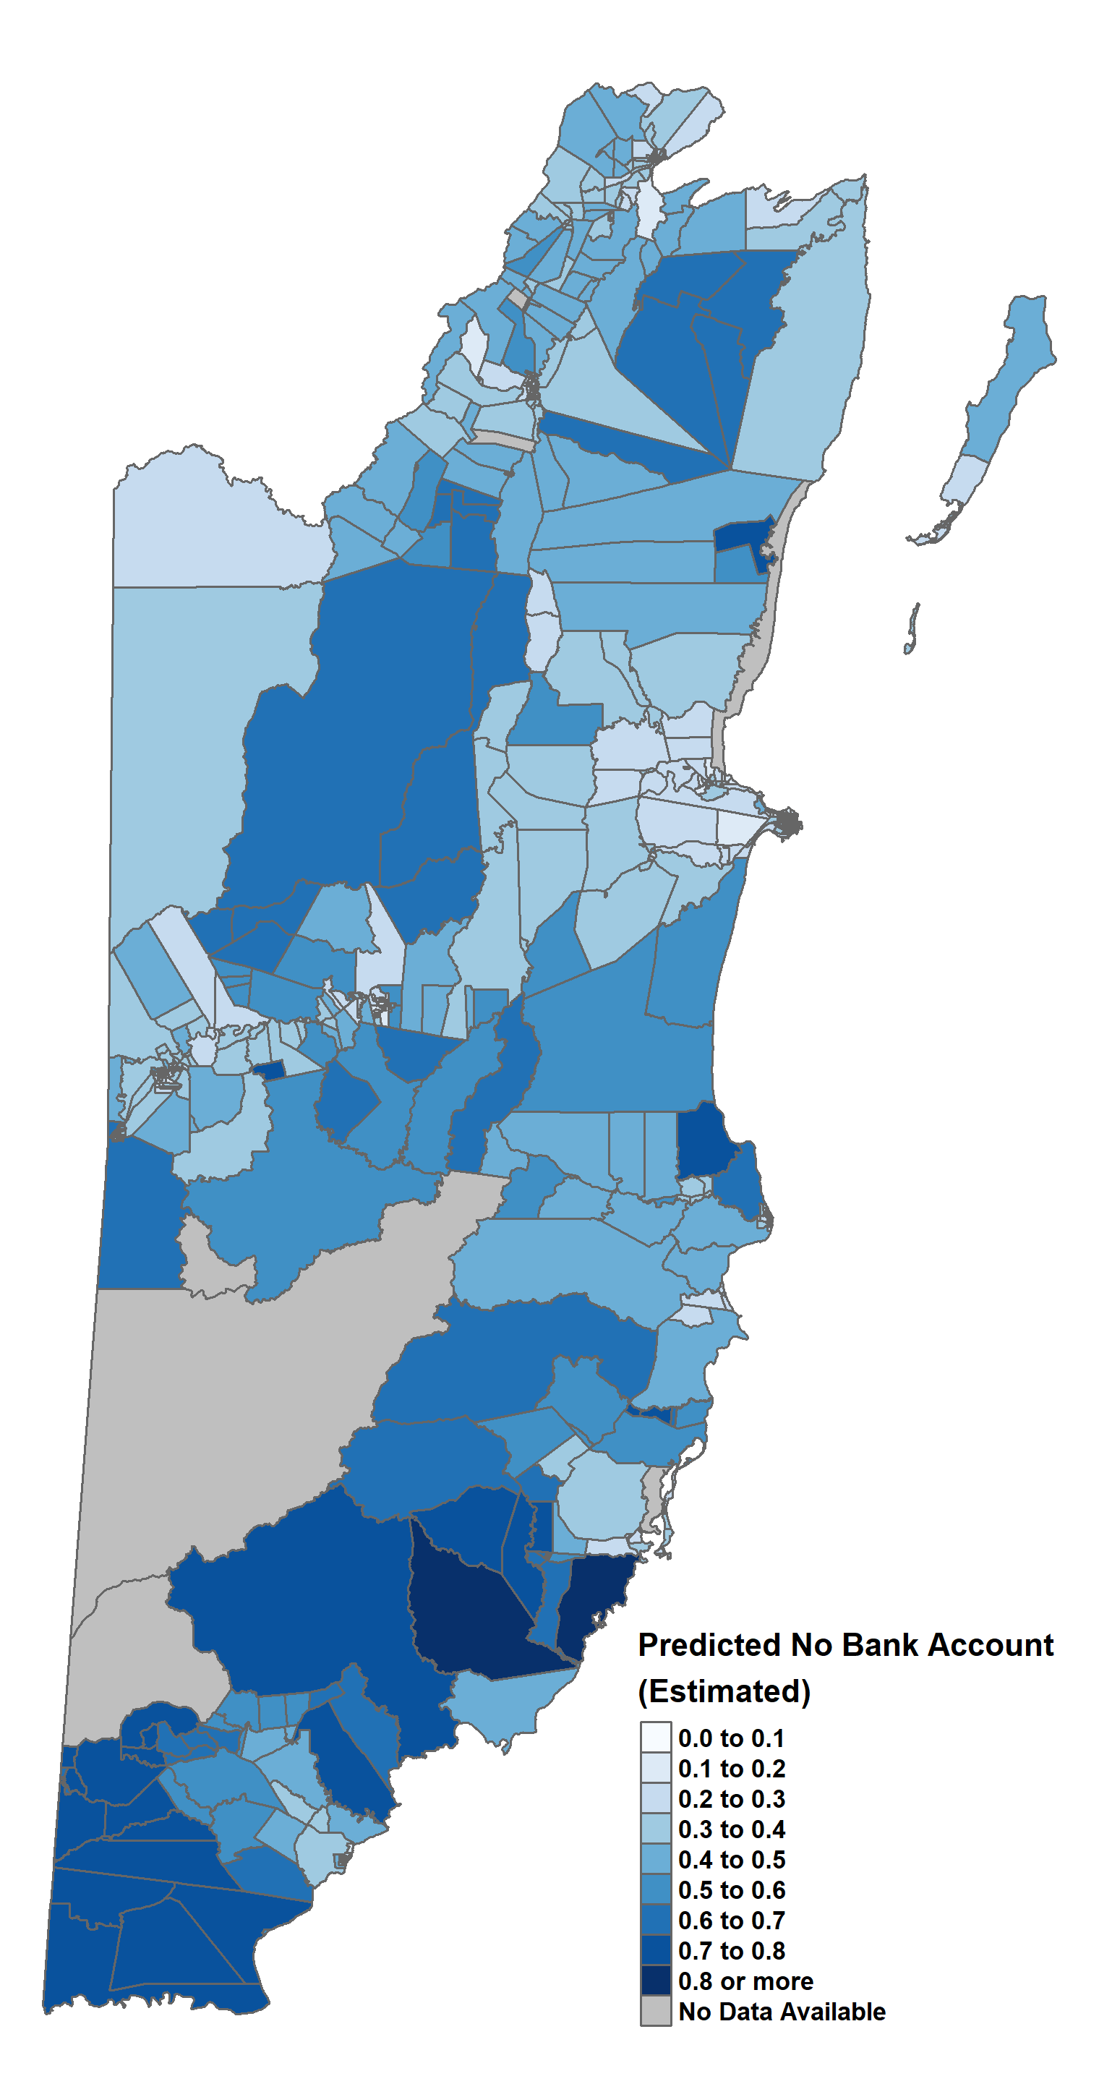
Estimated % of Households in ED Without Bank Accounts

Slide 21
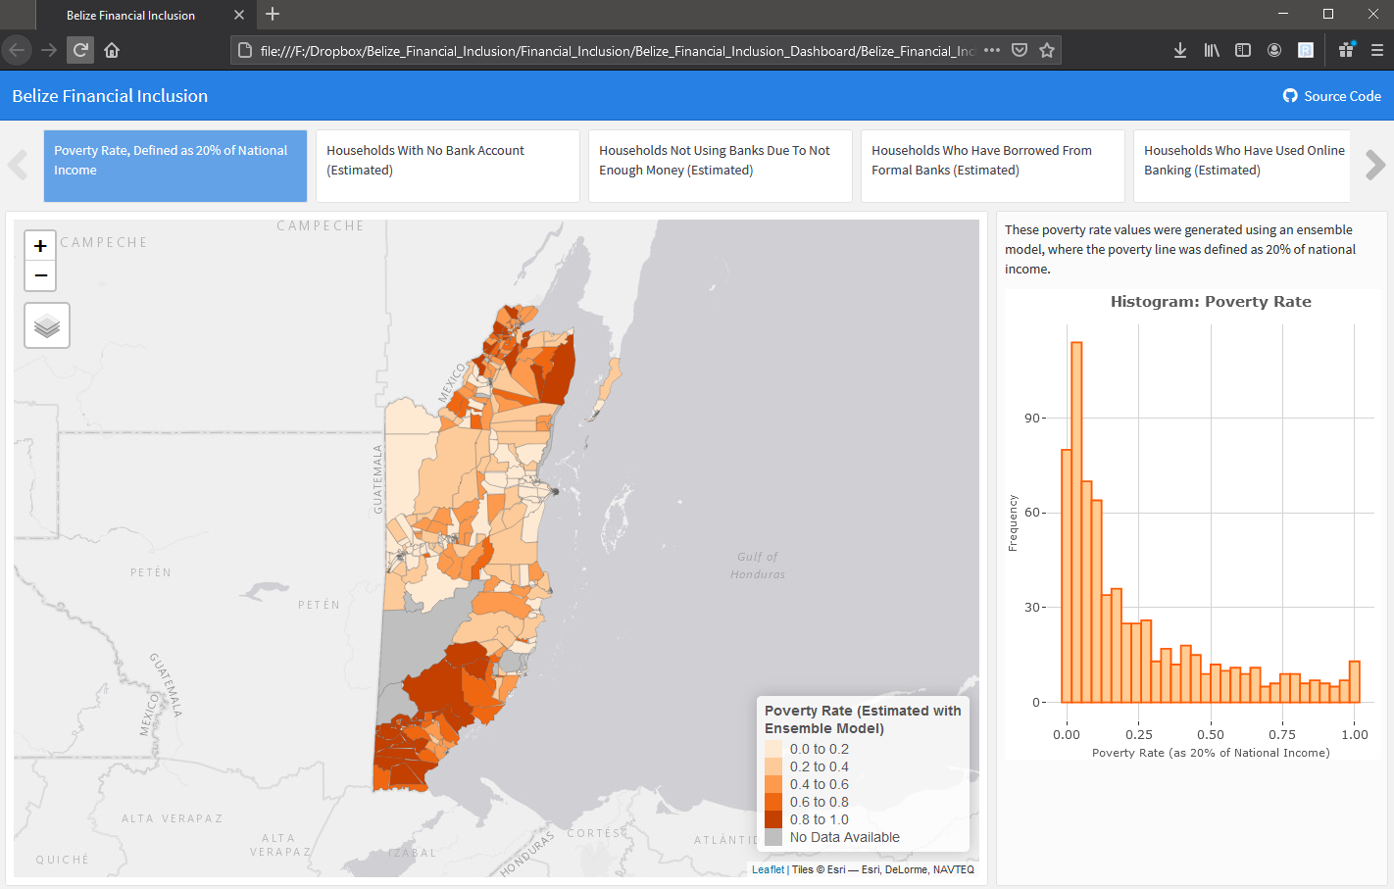
Dashboard To Interactively View Results
Click Link Below

